Slide 1
Function-Oriented Software Design (continued):

Slide 2
Organization of this Lecture
A larger example of Structured Analysis
Structured Design
A major objective of this lecture is that you should be able to develop structured design from any DFD model.
Examples
Summary

Slide 3
Review of Last Lecture
The goal of structured analysis:
perform functional decomposition.
represent using Data Flow Diagrams (DFDs).
DFDs are a hierarchical model:
We examined why any hierarchical model is easy to understand
During structured analysis:
Functional decomposition takes place
in addition, data decomposition takes place.
At the most abstract level:
context diagram
refined to more detailed levels.

Slide 4
DFD
Data flow diagram is graphical representation of flow of data in an information system.
It is capable of depicting incoming data flow, outgoing data flow and stored data.
The DFD does not mention anything about how data flows through the system.
Difference between DFD and Flowchart.
The flowchart depicts flow of control in program modules.
DFDs depict flow of data in the system at various levels. DFD does not contain any control or branch elements.

Slide 5
Types of DFD
Data Flow Diagrams are either Logical or Physical.
Logical DFD - This type of DFD concentrates on the system process, and flow of data in the system.
For example in a Banking software system, how data is moved between different entities.
Physical DFD - This type of DFD shows how the data flow is actually implemented in the system.
It is more specific and close to the implementation.

Slide 6
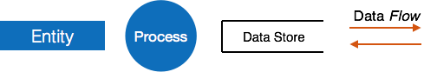
DFD Components
DFD can represent Source, destination, storage and flow of data using the following set of components –
Entities - Entities are source and destination of information data.
Process - Activities and action taken on the data are represented by Circle or Round-edged rectangles.
Data Storage - There are two variants of data storage - it can either be represented as a rectangle with absence of both smaller sides or as an open-sided rectangle with only one side missing.
Data Flow - Movement of data is shown by pointed arrows. Data movement is shown from the base of arrow as its source towards head of the arrow as destination.

Slide 7
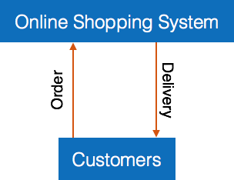
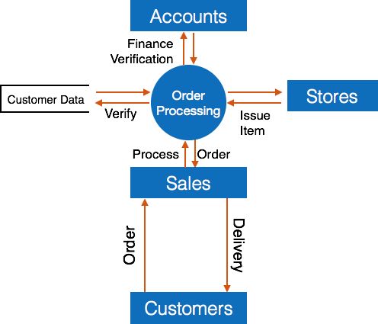
Levels of DFD
Level 0 - Highest abstraction level DFD is known as Level 0 DFD, which depicts the entire information system as one diagram concealing all the underlying details.
Level 0 DFDs are also known as context level DFDs.
Level 1 - The Level 0 DFD is broken down into more specific, Level 1 DFD. Level 1 DFD depicts basic modules in the system and flow of data among various modules.
Level 1 DFD also mentions basic processes and sources of information.

Slide 8


Slide 9
Levels of DFD
Level 2 - At this level, DFD shows how data flows inside the modules mentioned in Level 1.
Higher level DFDs can be transformed into more specific lower level DFDs with deeper level of understanding unless the desired level of specification is achieved.

Slide 10
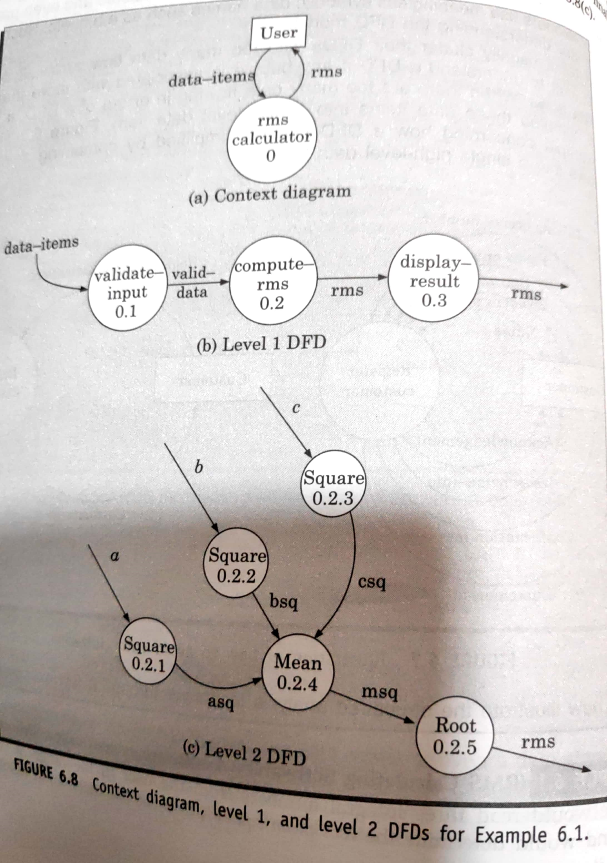
DFD of RMS Calculator

Slide 11
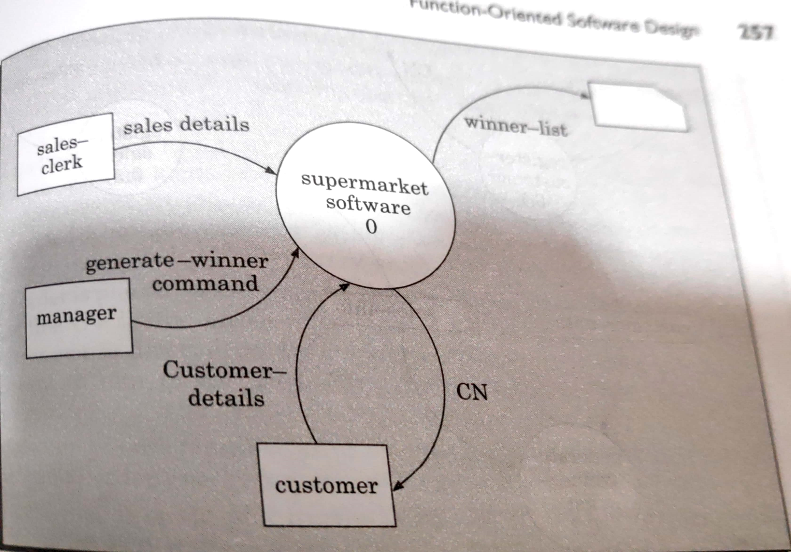
Supermarket prize scheme context diagram

Slide 12
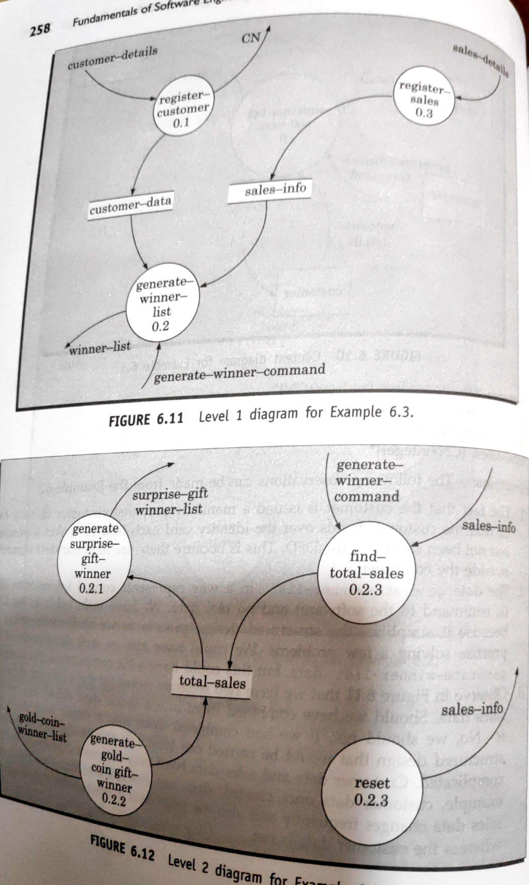
DFD of Supermarket prize scheme

Slide 13
Example 3: Trading-House Automation System (TAS)
A large trading house wants us to develop a software:
to automate book keeping activities associated with its business.
It has many regular customers:
who place orders for various kinds of commodities.
The trading house maintains names and addresses of its regular customers.
Each customer is assigned a unique customer identification number (CIN).
As per current practice when a customer places order:
the accounts department first checks the credit-worthiness of the customer.

Slide 14
Example: Trading-House Automation System (TAS)
The credit worthiness of a customer is determined:
by analyzing the history of his payments to the bills sent to him in the past.
If a customer is not credit-worthy:
his orders are not processed any further
an appropriate order rejection message is generated for the customer.
If a customer is credit-worthy:
items he/she has ordered are checked against the list of items the trading house deals with.
The items that the trading house does not deal with:
are not processed any further
an appropriate message for the customer for these items is generated.

Slide 15
Example: Trading-House Automation System (TAS)
The items in a customer's order that the trading house deals with:
are checked for availability in the inventory.
If the items are available in the inventory in desired quantities:
a bill with the forwarding address of the customer is printed.
a material issue slip is printed.
The customer can produce the material issue slip at the store house:
take delivery of the items.
inventory data adjusted to reflect the sale to the customer.

Slide 16
Example: Trading-House Automation System (TAS)
If an ordered item is not available in the inventory in sufficient quantity:
to be able to fulfill pending orders store details in a "pending-order" file :
out-of-stock items along with quantity ordered.
customer identification number
The purchase department:
would periodically issue commands to generate indents.
When generate indents command is issued:
the system should examine the "pending-order" file
determine the orders that are pending
total quantity required for each of the items.

Slide 17
Example: Trading-House Automation System (TAS)
TAS should find out the addresses of the vendors who supply the required items:
examine the file containing vendor details (their address, items they supply etc.)
print out indents to those vendors.
TAS should also answers managerial queries:
statistics of different items sold over any given period of time
corresponding quantity sold and the price realized.

Slide 18
Context Diagram
C

Slide 19
Level 1 DFD
0.1
0.3
0.2
0.4

Slide 20
Example: Data Dictionary
response: [bill + material-issue-slip, reject-message]
query: period /* query from manager regarding sales statistics*/
period: [date+date,month,year,day]
date: year + month + day
year: integer
month: integer
day: integer
order: customer-id + {items + quantity}*
accepted-order: order /* ordered items available in inventory */
reject-message: order + message /* rejection message */
pending-orders: customer-id + {items+quantity}*
customer-address: name+house#+street#+city+pin

Slide 21
Example: Data Dictionary
item-name: string
house#: string
street#: string
city: string
pin: integer
customer-id: integer
bill: {item + quantity + price}* + total-amount + customer-address
material-issue-slip: message + item + quantity + customer-address
message: string
statistics: {item + quantity + price }*
sales-statistics: {statistics}*
quantity: integer

Slide 22
Observation
From the examples,
observe that DFDs help create:
data model
function model
As a DFD is refined into greater levels of detail:
the analyst performs an implicit functional decomposition.
At the same time, refinements of data takes place.

Slide 23
Guidelines For Constructing DFDs
Context diagram should represent the system as a single bubble:
Many beginners commit the mistake of drawing more than one bubble in the context diagram.
All external entities should be represented in the context diagram:
external entities should not appear at any other level of DFD.
Only 3 to 7 bubbles per diagram should be allowed:
each bubble should be decomposed to between 3 and 7 bubbles.

Slide 24
Guidelines For Constructing DFDs
A common mistake committed by many beginners:
attempting to represent control information in a DFD.
e.g. trying to represent the order in which different functions are executed.
A DFD does not represent control information:
when or in what order different functions (processes) are invoked
the conditions under which different functions are invoked are not represented.
For example, a function might invoke one function or another depending on some condition.

Slide 25
Example-1
Check the input value:
If the input value is less than -1000 or greater than +1000 generate an error message
otherwise search for the number
r

Slide 26
Guidelines For Constructing DFDs
If a bubble A invokes either bubble B or bubble C depending on some conditions:
represent the data that flows from bubble A to bubble B and bubbles A to C
not the conditions depending on which a process is invoked.

Slide 27
Example-2
A function accepts the book name to be searched from the user
If the entered book name is not a valid book name
generates an error message,
If the book name is valid,
searches the book name in the database.

Slide 28
Guidelines For Constructing DFDs
All functions of the system must be captured in the DFD model:
no function specified in the SRS document should be overlooked.
Only those functions specified in the SRS document should be represented:
do not assume extra functionality of the system not specified by the SRS document.

Slide 29
Commonly made errors
Unbalanced DFDs
Forgetting to mention the names of the data flows
Unrepresented functions or data
External entities appearing at higher level DFDs
Trying to represent control aspects
Context diagram having more than one bubble
A bubble decomposed into too many bubbles in the next level
Terminating decomposition too early
Nouns used in naming bubbles

Slide 30
Shortcomings of the DFD Model
DFD models suffer from several shortcomings:
DFDs leave ample scope to be imprecise.
In a DFD model, we infer about the function performed by a bubble from its label.
A label may not capture all the functionality of a bubble.

Slide 31
Shortcomings of the DFD Model
For example, a bubble named find-book-position has only intuitive meaning:
does not specify several things:
what happens when some input information is missing or is incorrect.
Does not convey anything regarding what happens when book is not found
or what happens if there are books by different authors with the same book title.

Slide 32
Shortcomings of the DFD Model
Control information is not represented:
For instance, order in which inputs are consumed and outputs are produced is not specified.

Slide 33
Creating Data Flow Diagrams
Lemonade Stand Example

Slide 34
Creating Data Flow Diagrams
Example
Steps:
The operations of a simple lemonade stand will be used to demonstrate the creation of dataflow diagrams.
Create a list of activities
Old way: no Use-Case Diagram
New way: use Use-Case Diagram
Construct Context Level DFD (identifies sources and sink)
Construct Level 1 DFD (identifies manageable sub processes )
Construct Level 2- n DFD (identifies actual data flows and data stores )

Slide 35
Creating Data Flow Diagrams
Example
Create a list of activities
Think through the activities that take place at a lemonade stand.
Customer Order
Serve Product
Collect Payment
Produce Product
Store Product

Slide 36
Creating Data Flow Diagrams
Example
Create a list of activities
Also think of the additional activities needed to support the basic activities.
Customer Order
Serve Product
Collect Payment
Produce Product
Store Product
Order Raw Materials
Pay for Raw Materials
Pay for Labor

Slide 37
Creating Data Flow Diagrams
Example
Create a list of activities
Group these activities in some logical fashion, possibly functional areas.
Customer Order
Serve Product
Collect Payment
Produce Product
Store Product
Order Raw Materials
Pay for Raw Materials
Pay for Labor

Slide 38
Creating Data Flow Diagrams
Example
Construct Context Level DFD (identifies sources and sink)
Create a context level diagram identifying the sources and sinks (users).
Context Level DFD
CUSTOMER
0.0
Lemonade System
Sales Forecast
EMPLOYEE
Order
Customer Order
Serve Product
Collect Payment
Produce Product
Store Product
Order Raw Materials
Pay for Raw Materials
Pay for Labor
Production Schedule
Product Served
Pay
Payment
Time Worked
Received Goods
Payment
Purchase Order
VENDOR

Slide 39
Creating Data Flow Diagrams
Construct Level 1 DFD (identifies manageable sub processes )
Example
Create a level 1 diagram identifying the logical subsystems that may exist.
Level 1 DFD
1.0
Sale
Customer Order
Serve Product
Collect Payment
Produce Product
Store Product
Order Raw Materials
Pay for Raw Materials
Pay for Labor
Customer Order
Sales Forecast
Product Ordered
CUSTOMER
Payment
2.0
Production
EMPLOYEE
Production Schedule
Product Served
Received Goods
Inventory
VENDOR
3.0
Procure-ment
Purchase Order
Order Decisions
Payment
Pay
Time Worked
4.0
Payroll

Slide 40
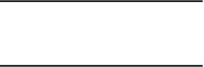
Creating Data Flow Diagrams
Example
Construct Level 2- n DFD (identifies actual data flows and data stores )
Create a level 2 decomposing the processes in level 1 and identifying data stores.
Level 2 DFD
CUSTOMER
Customer Order
Customer Order
Serve Product
Collect Payment
Produce Product
Store Product
Order Raw Materials
Pay for Raw Materials
Pay for Labor
ORDER
Request for Forecast
1.1
Record Order
1.3
Produce Sales Forecast
Severed Order
Payment
Sales Forecast
1.2
Receive Payment
PAYMENT

Slide 41
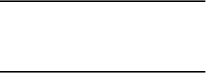
Creating Data Flow Diagrams
Example
Construct Level 2 (continued)
Create a level 2 decomposing the processes in level 1 and identifying data stores.
Level 2 DFD
Product Order
ORDER
Customer Order
Serve Product
Collect Payment
Produce Product
Store Product
Order Raw Materials
Pay for Raw Materials
Pay for Labor
2.1
Serve Product
Quantity Severed
RAW MATERIALS
Production Schedule
2.2
Produce Product
Quantity Used
INVENTORTY
Production Data
2.3
Store
Product
Quantity Produced & Location Stored

Slide 42

Creating Data Flow Diagrams
Example
Construct Level 2 (continued)
Create a level 2 decomposing the processes in level 1 and identifying data stores.
Level 2 DFD
Order Decision
3.1
Produce Purchase Order
PURCHASE ORDER
Customer Order
Serve Product
Collect Payment
Produce Product
Store Product
Order Raw Materials
Pay for Raw Materials
Pay for Labor
Quantity On-Hand
RAW MATERIALS
Quantity Received
Received Goods
3.2
Receive Items
RECEIVED ITEMS
Payment Approval
3.3
Pay Vendor
VENDOR
Payment

Slide 43
Creating Data Flow Diagrams
Example
Construct Level 2 (continued)
Create a level 2 decomposing the processes in level 1 and identifying data stores.
Level 2 DFD
Time Worked
4.1
Record Time Worked
TIME CARDS
Customer Order
Serve Product
Collect Payment
Produce Product
Store Product
Order Raw Materials
Pay for Raw Materials
Pay for Labor
Employee ID
EMPLOYEE
Payroll Request
4.2
Calculate Payroll
Unpaid time cards
PAYROLL
Payment Approval
4.3
Pay Employee
PAYMENTS
Payment

Slide 44
Process Decomposition
1.0
Sale
1.1
Record Order
1.2
Receive Payment
2.0
Production
2.1
Serve Product
2.2
Produce Product
2.3
Store
Product
0.0
Lemonade System
3.0
Procure-ment
3.1
Produce Purchase Order
3.2
Receive Items
3.3
Pay Vendor
4.0
Payroll
4.1
Record Time Worked
4.2
Calculate Payroll
4.3
Pay Employee
Context Level
Level 1
Level 2

Slide 45
Commonly made errors
Unbalanced DFDs
Forgetting to mention the names of the data flows
Unrepresented functions or data
External entities appearing at higher level DFDs
Trying to represent control aspects
Context diagram having more than one bubble
A bubble decomposed into too many bubbles in the next level
Terminating decomposition too early
Nouns used in naming bubbles

Slide 46
Shortcomings of the DFD Model
DFD technique does not provide:
any clear guidance as to how exactly one should go about decomposing a function:
one has to use subjective judgement to carry out decomposition.
Structured analysis techniques do not specify when to stop a decomposition process:
to what length decomposition needs to be carried out.

Slide 47
Extending DFD Technique to Real-Time Systems
For real-time systems (systems having time bounds on their actions),
essential to model control flow and events.
Widely accepted technique: Ward and Mellor technique.
a type of process (bubbles) that handles only control flows is introduced.
These processes are represented using dashed circles.

Slide 48
Structured Design
The aim of structured design
transform the results of structured analysis (i.e., a DFD representation) into a structure chart.
A structure chart represents the software architecture:
various modules making up the system,
module dependency (i.e. which module calls which other modules),
parameters passed among different modules.

Slide 49
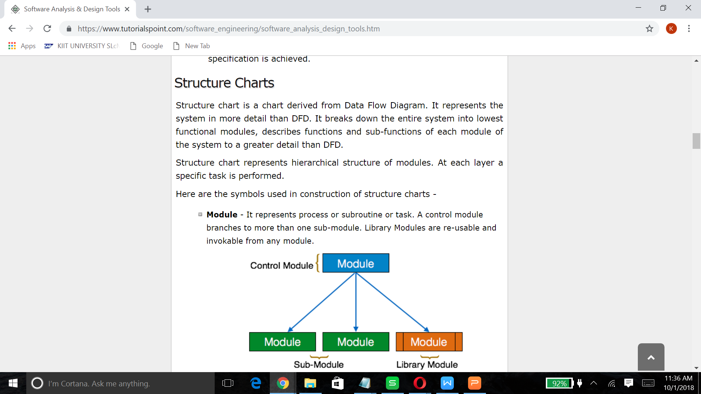

Slide 50
Structure Chart
Structure chart representation
easily implementable using programming languages.
Main focus of a structure chart:
define the module structure of a software,
interaction among different modules,
procedural aspects (e.g, how a particular functionality is achieved) are not represented.

Slide 51
1. Basic building blocks of structure chart
Rectangular box:
A rectangular box represents a module.
annotated with the name of the module it represents.

Slide 52
2. Arrows
An arrow between two modules implies:
during execution control is passed from one module to the other in the direction of the arrow.

Slide 53
3. Data flow Arrows
Data flow arrows represent:
data passing from one module to another in the direction of the arrow.

Slide 54
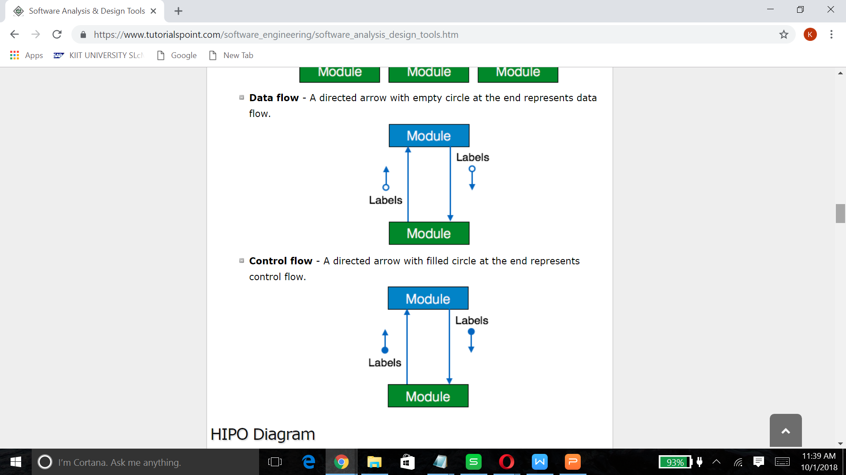

Slide 55
4. Library modules
Library modules represent frequently called modules:
a rectangle with double side edges.
Simplifies drawing when a module is called by several modules.

Slide 56
5. Selection
The diamond symbol represents:
one module of several modules connected to the diamond symbol is invoked depending on some condition.

Slide 57
6. Repetition
A loop around control flow arrows denotes that the concerned modules are invoked repeatedly.

Slide 58
Structure Chart
There is only one module at the top:
the root module.
There is at most one control relationship between any two modules:
if module A invokes module B,
module B cannot invoke module A.
The main reason behind this restriction:
consider modules in a structure chart to be arranged in layers or levels.

Slide 59
Structure Chart
The principle of abstraction:
does not allow lower-level modules to invoke higher-level modules:
But, two higher-level modules can invoke the same lower-level module.

Slide 60
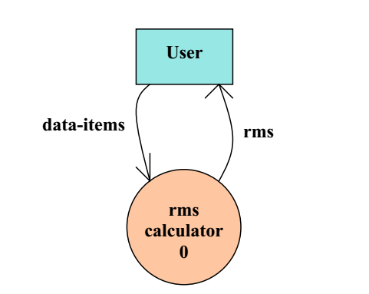
RMS calculator
RMS Calculator :
Reads three integers and determine Root Mean Square

Slide 61
Example

Slide 62
Bad Design

Slide 63
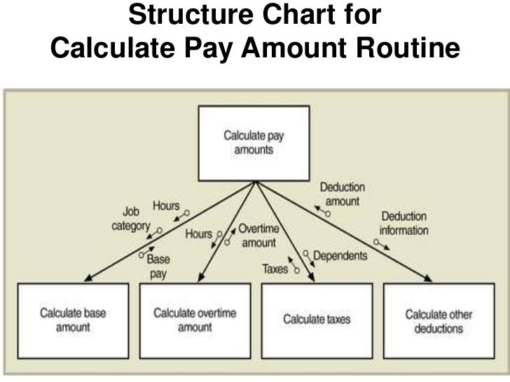

Slide 64
Shortcomings of Structure Chart
By looking at a structure chart:
we can not say whether a module calls another module just once or many times.
Also, by looking at a structure chart:
we can not tell the order in which the different modules are invoked.

Slide 65
Flow Chart (Aside)
We are all familiar with the flow chart representations:
Flow chart is a convenient technique to represent the flow of control in a system.
if(c == 100)
P=20
else p= 80
while(p>20)
print(student mark)
A=B
C==100 ?
P=20
P=80
p>20 ?
No
PRINT

Slide 66
Flow Chart versus Structure Chart
A structure chart differs from a flow chart in three principal ways:
It is difficult to identify modules of a software from its flow chart representation.
Data interchange among the modules is not represented in a flow chart.
Sequential ordering of tasks inherent in a flow chart is suppressed in a structure chart.

Slide 67
Transformation of a DFD Model into Structure Chart
Two strategies exist to guide transformation of a DFD into a structure chart:
Transform Analysis
Transaction Analysis

Slide 68
Transform Analysis
The first step in transform analysis:
Divide the DFD into 3 types of parts:
input,
logical processing,
output.

Slide 69
Transform Analysis
Input portion in the DFD:
processes which convert input data from physical to logical form.
e.g. read characters from the terminal and store in internal tables or lists.
Each input portion:
called an afferent branch.
Possible to have more than one afferent branch in a DFD.

Slide 70
Transform Analysis
Output portion of a DFD:
transforms output data from logical form to physical form.
e.g., from list or array into output characters.
Each output portion:
called an efferent branch.
The remaining portions of a DFD
called central transform

Slide 71
Transform Analysis
Derive structure chart by drawing one functional component for:
the central transform,
each afferent branch,
each efferent branch.

Slide 72
Transform Analysis
Identifying the highest level input and output transforms:
requires experience and skill.
Some guidelines:
trace the inputs until a bubble is found whose output cannot be deduced from the inputs alone.
Processes which validate input are not central transforms.
Processes which sort input or filter data from it are.

Slide 73
Transform Analysis
First level of structure chart:
draw a box for each input and output units
a box for the central transform.
Next, refine the structure chart:
add subfunctions required by each high-level module.
Many levels of modules may required to be added.

Slide 74
Factoring
The process of breaking functional components into subcomponents.
Factoring includes adding:
read and write modules,
error-handling modules,
initialization and termination modules, etc.
Finally check:
whether all bubbles have been mapped to modules.

Slide 75
Example 1: RMS Calculating Software

Slide 76
Example 1: RMS Calculating Software
From a cursory analysis of the problem description,
easy to see that the system needs to perform:
accept the input numbers from the user,
validate the numbers,
calculate the root mean square of the input numbers,
display the result.

Slide 77
Example 1: RMS Calculating Software
0.1
0.2
0.3
0.4
RMS

Slide 78
Example 1: RMS Calculating Software
By observing the level 1 DFD:
identify read-number and validate-number bubbles as the afferent branch
display as the efferent branch.

Slide 79
Example 1: RMS Calculating Software
r
r

Slide 80
Example 2: Tic-Tac-Toe Computer Game
As soon as either of the human player or the computer wins,
a message congratulating the winner should be displayed.
If neither player manages to get three consecutive marks along a straight line,
and all the squares on the board are filled up,
then the game is drawn.
The computer always tries to win a game.

Slide 81
Context Diagram for Example 2

Slide 82
Level 1 DFD
d

Slide 83
Structure Chart

Slide 84
Transaction Analysis
Useful for designing transaction processing programs.
Transform-centered systems:
characterized by similar processing steps for every data item processed by input, process, and output bubbles.
Transaction-driven systems,
one of several possible paths through the DFD is traversed depending upon the input data value.

Slide 85
Transaction Analysis
Transaction:
any input data value that triggers an action:
For example, selected menu options might trigger different functions.
Represented by a tag identifying its type.
Transaction analysis uses this tag to divide the system into:
several transaction modules
one transaction-center module.

Slide 86
Transaction analysis
1
2
3

Slide 87
Level 1 DFD for TAS
I

Slide 88
Structure Chart

Slide 89
Summary
We first discussed structured analysis of a larger problem.
We defined some general guidelines
for constructing a satisfactory DFD model.
The DFD model though simple and useful
does have several short comings.
We then started discussing structured design.

Slide 90
Summary
Aim of structured design:
transform a DFD representation into a structure chart.
Structure chart represents:
module structure
interaction among different modules,
procedural aspects are not represented.

Slide 91
Summary
Structured design provides two strategies to transform a DFD into a structure chart:
Transform Analysis
Transaction Analysis

Slide 92
Summary
We Discussed three examples of structured design.
It takes a lot of practice to become a good software designer:
Please try to solve all the problems listed in the Excercise section of Text Book

